Slide 1
Design Ventura 2021-22
Launch Presentation

Slide 2
What is Design Ventura?
Design and enterprise project for students in Years 9,10 and 11
Students work in teams of 4-6 to answer a live brief set by a leading designer​
Top ten shortlisted state school teams will pitch their ideas to a panel of expert judges​
The top three international/independent schools will submit a 3-minute video pitch​
The winning team will work with professional designers to develop their product for sale in the Design Museum Shop​
Watch the overview film ​
​
​
​

Slide 3
Design Ventura is a national and international competition ​
Now in its twelfth year ​
Design Ventura has supported more than 108,200 students since its inception in 2010​
Quickly becoming a benchmark of design talent in schools ​
10 student products have been made and sold in the Design Museum Shop raising more than £14,000 for charity​

Slide 4
Design Ventura 20201-22
Student Brief
Be inspired by your senses to create a product that improves everyday life​
Can be sold for around £15 and should cost about £7 per product to make ​
Can be sold in the Design Museum Shop and is targeted at a specified audience​
Must demonstrate sustainable design and simple manufacturing processes​

Slide 5
Design Ventura
Past Winners

Slide 6
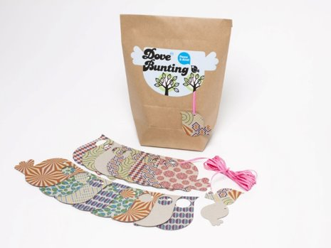
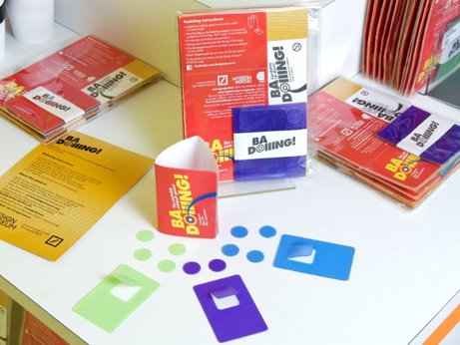
Design Ventura Past Winners​
2010-2021
2010 ​ Dove bunting​ Haberdashers’ Aske’s Hatcham College ​ Carboard bunting you can personalise​ Materials: Card, paper and ribbon​
​ 2011 ​ Badoiiing​ Walworth Academy ​ A travel version of the game tiddlywinks​ Materials: Polypropylene sheet, travel card wallet and card​ ​

Slide 7
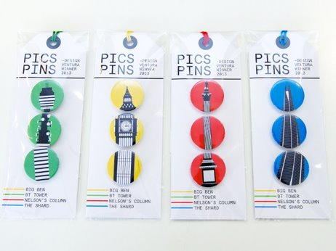
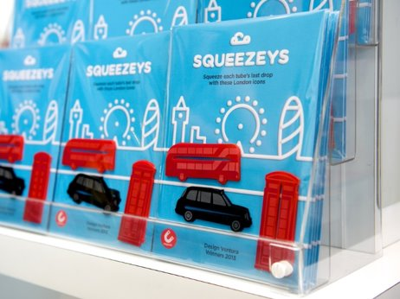
Design Ventura Past Winners​
2010-2021
2012 ​ Pics Pins ​ Trinity ​ Mix and match London landmark badges​ Materials: Pin badges and card​
2013 ​ Squeezeys ​ Weald of Kent Grammar School ​ London themed tube squeezers ​ Materials: Acrylic, card and magnet​ ​
​

Slide 8
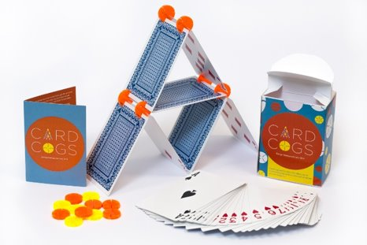
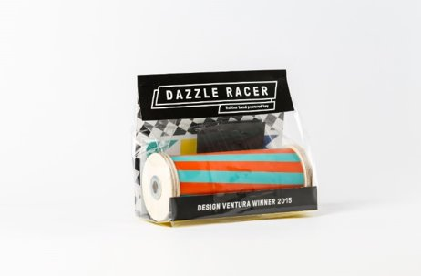
Design Ventura Past Winners​
2010-2021
2014​ Card Cogs​ Burnage Academy for Boys ​ Acrylic discs that allow you to construct structures out of playing cards​ Materials: acrylic and card ​
2015​ Dazzle Racer ​ Finchley Catholic High School ​ Wind up racers that you personalise with stickers ​ Materials: Wood, elastic band and stickers​ ​
​

Slide 9
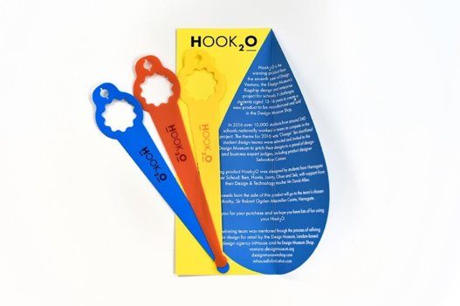
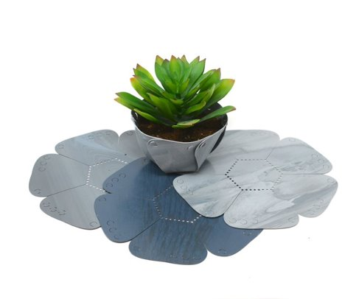
Design Ventura Past Winners​
2010-2021
2016 ​ Hook20 ​ Harrogate Grammar School ​A hook for holding a water bottle outside of your bag to avoid spillages​ Materials: Polypropylene sheet​
2017 ​ Petal Pot ​A plant pot that grows with the plant​ Weatherhead High School ​ Materials: Gumtec ​(recycled chewing gum)​ Read their story
​

Slide 10
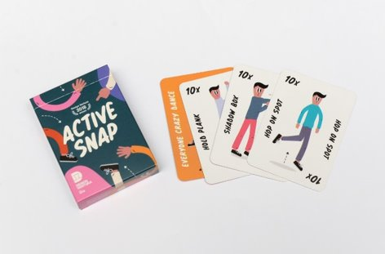
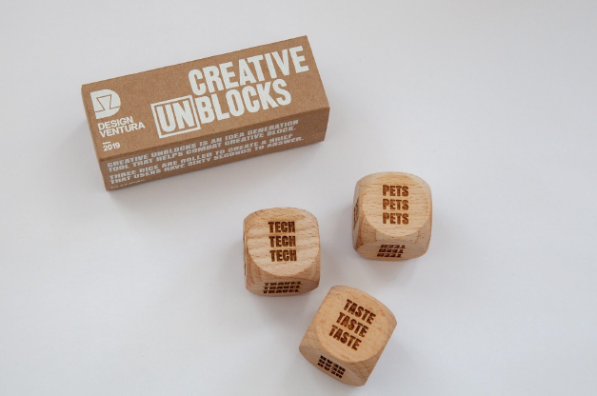
Design Ventura Past Winners​
2010-2021
2018 ​ Active Snap ​ Simon Balle All-Through School ​ A version of the game snap that gets players active​ Materials: Car​d Read their story
2019​ Creative [Un]blocks ​ Twynham School​ Dice that help combat creative block​ Materials: Wooden blocks and cardboard packaging Read their story
​
​

Slide 11
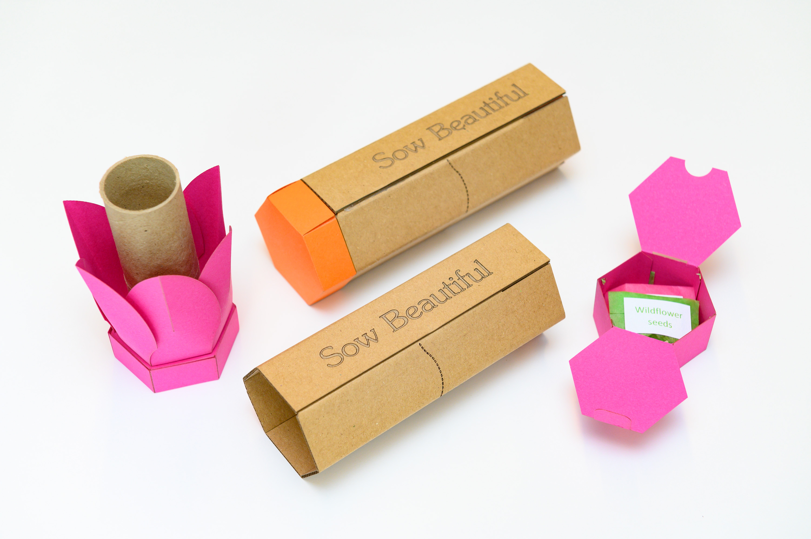
Design Ventura Past Winners​
2010-2021
2020 ​ Sow Beautiful​ Heckmondwike Grammar School A seed cannon to create a source of pollen for bees and help combat bee decline. Materials: Card​, biodegradable balloon, wildflower seeds Read their story
2021-22 ​Could it be you?
​

Slide 12
Top tips for creating a winning idea​
From the Design Museum team ​
Work as a team - be good listeners and contributors​
Show an understanding of sustainable design​
Appeal to Design Museum Shop customers rather than general retailers​
Use readily available materials and simple manufacturing processes that are achievable for £7 per product​
The winning products since 2010 have been simple and original ideas​

Slide 13
Top tips for creating a winning idea​
From the Design Museum team ​
Simple means:​
An idea that is easy to understand and use​
One main manufacturing process such as die-cutting, laser cutting or printing​
One or two key materials such as card or wood​, see sustainable materials sheet
Original means:​
It stands out from other competition entries​
Clear concept that relates to the brief​
Appeals specifically to Design Museum Shop customers​

Slide 14
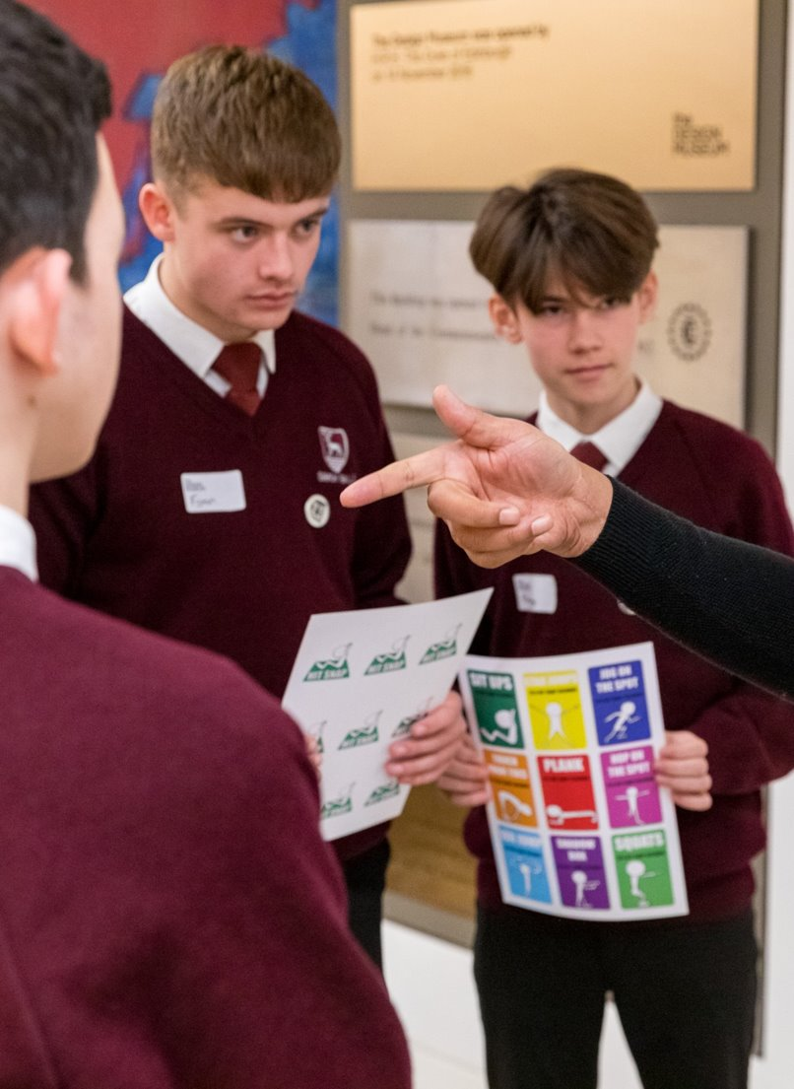
Top tips for creating a winning idea​
From the Design Museum team ​
We do not want to see:​
Masks, desk tidies, pencil cases, earphone wraps, mug cosies, mobile phone cases and holders​
Injection moulding or other expensive materials or processes​

Slide 15
Design Ventura 2021-22
Key Dates
8 Sept: Brief setter announced
14 Sept – 17 Dec: Museum workshops
14 Sept – Jan 2022: Online & in school workshops
15 Sept – 6 Oct: Weekly webinars
23 Feb 2022: Submission deadline
22 March 2022: Pitching Day, Winchester House
28 April 2022: Celebration Event, the Design Museum

Slide 16
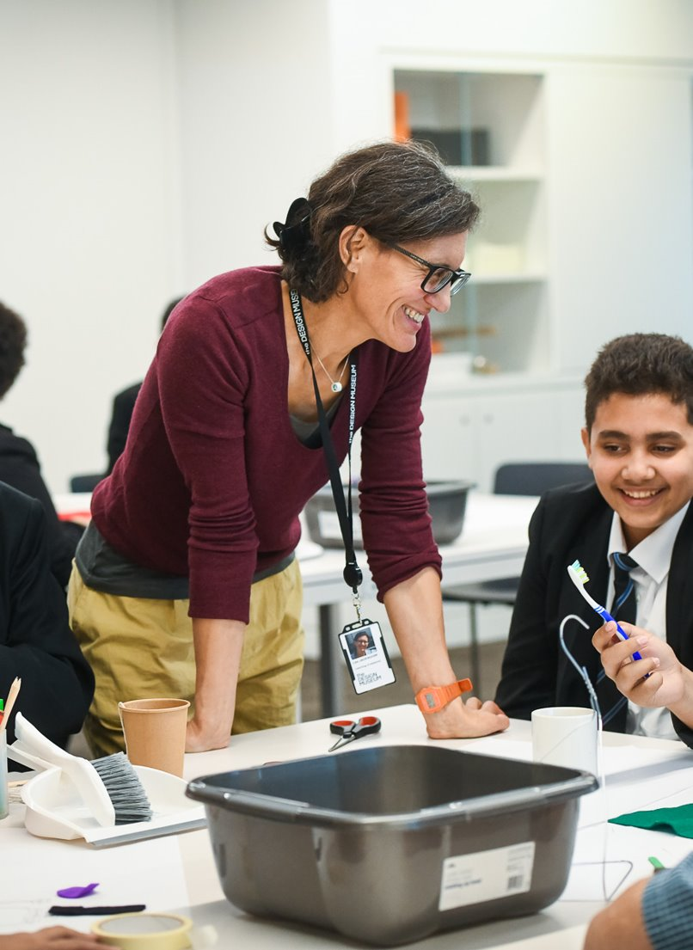
Design Ventura 2021-22
Getting Started
We suggest you start by researching the Design Museum Shop and its customers. You can start with these:​
Shop film​
Shop presentation
Shop fact sheet
DM Shop website​

Slide 17
Design Ventura 2021-22
Getting Started
Look in detail at the target user group you have chosen:​
What are their needs?​
What do they do with their day?​
What problems or issues do they encounter? ​
What products do they buy/use? ​
How can this be improved? ​

Slide 18
Get in touch
Email ​ ventura@designmuseum.org​
Stay up to date​ ​ Twitter @DesignVentura​ Instagram @design_ventura​ Facebook Design Ventura​
​

